Slide 1
LGBTQ-Police Relations in the United States
A Presentation by M. Moore for
the American Bar Association
Rule of Law Initiative – Moscow
April 2015

Slide 2
Overview
National Issues
Proposed Federal Reforms
Local Issues: Washington, DC
Local Strategies for Improving Police-LGBTQ Relations

Slide 3
Police Mistreatment of LGBTQ Individuals

Slide 4
LGBTQ People in the U.S. Experience
Profiling: sexual, homophobic, and transphobic harassment, stops and searches
Targeting for “lewd conduct” and prostitution-related offenses
Demands for identification and “consent” searches during street and car stops
Invasive, violative searches to satisfy officer doubts or curiosity

Slide 5
Protected and Served?
Conducted in 2012 by Lambda Legal
2,376 people identifying as LGBTQ
1,682 or 73% had face-to-face contact with the police in the past five years
Notes:
Lambda Legal is a national organization committed to achieving full recognition of the civil rights of LGBT people and people living with HIV through impact litigation, education and public policy work.

Slide 6
Hostile Attitudes
21% reported hostile attitudes from officers
31% of respondents under age 30
32% of respondents of color (including 26% of Native American, 27% of African American, and 40% of Latina/o respondents)
38% of respondents of color under 30
32% of TGNC respondents (30% of transgender)
35% of low-income respondents
Notes:
TGNC = transgender and gender non-conforming.

Slide 7
Harassment and Assault
14% reported verbal assault by the police
3% reported sexual harassment
2% reported physical assault
People of color, low-income people, and people living with HIV reported harassment and assault by police more frequently than survey respondents as a whole

Slide 8
Assault
Physical Assault
2% of all respondents
4% of respondents of color
4% of TGNC respondents
5% of low-income respondents
6% of HIV-positive respondents
Verbal Assault
14% of all respondents
21% of HIV-positive respondents
22% of TGNC respondents
24% of respondents of color
25% of low-income respondents
Notes:
LGBT people of color an TGNC people reported physical and verbal assaults at higher rates.

Slide 9
Sexual Harassment
3% of all respondents
5% of respondents of color
5% of HIV-positive respondents
7% of low-income respondents
7% of TGNC respondents
Notes:
Again, the numbers are higher for TGNC people and LGBT people of color.

Slide 10
Inadequate Police Response
Of 238 respondents who experienced physical assault:
62% reported experiencing at least one incident in which police failed to fully address their complaints about physical assault
73% of HIV-positive assault victims and 70% of trans-feminine assault victims experienced police neglect of their physical assault complaint
Notes:
238 or 11% percent of all survey respondents reported that they were a victim of physical assault in the last five years. Not by the police but in general.
35% of all TGNC respondents and 44% of all low-income respondents reported having been the victim of physical assault.
59% of HIV-negative physical assault victims and 60% percent of cisgender (non-TGNC) assault victims experienced police neglect of their physical assault complaint.

Slide 11
Possible Federal Solutions
Strategies that Could Change the Way Police Treat LGBTQ People

Slide 12
Anti-Discrimination Directives
Prohibit the use of race, color, ethnicity, national origin, immigration status, religion, gender, disability, sexual orientation, or gender identity as a factor, to any extent or degree, in
establishing reasonable suspicion or probable cause,
exercising discretion to conduct a warrantless search or seek a search warrant,
or effecting arrest.
Notes:
Except as part of an actual and apparently credible description of specific suspect or suspects in a criminal investigation.
Would be applicable to federal law enforcement agencies such as the FBI.
Note: The Department of Justice provides some oversight of State and municipal police agencies in the form of consent decrees.
A consent decree is an agreement between involved parties submitted in writing to a court. Once approved by the judge, it becomes legally binding.
Whenever the Department of Justice has reasonable cause to believe that civil rights violations have occurred, they may obtain a court order to eliminate the pattern or practice.
The Department of Justice has recently entered into consent decrees with the New Orleans Police Department (NOPD) and the Commonwealth of Puerto Rico (PRPD), among others.
These consent decrees contain anti-discrimination directives that would apply to local police agencies.

Slide 13
The End Racial Profiling Act
S. 1038 / H.R. 2581; proposed federal legislation
Most recently introduced in the Committee on the Judiciary Subcommittee on the Constitution, Civil Rights, and Human Rights (12/2014)
Creates a federal prohibition against racial profiling
Notes:
First introduced in 2013.

Slide 14
End Racial Profiling Act (Continued)
Defines “racial profiling”:
“The practice of a law enforcement agent or agency relying, to any degree, on race, ethnicity, national origin, or religion in selecting which individual to subject to routine or spontaneous investigatory activities or in deciding upon the scope and substance of law enforcement activity following the initial investigatory procedure, except when there is trustworthy information, relevant to the locality and timeframe, that links a person of a particular race, ethnicity, national origin, or religion to an identified criminal incident or scheme.”
Notes:
Could easily add provisions prohibiting profiling based on gender, gender identity and expression, and sexual orientation. But, language like that could hold up passage of the legislation.

Slide 15
End Racial Profiling Act (Continued)
Mandates data collection
Provides funding for targeted retraining of law enforcement officials
Holds law enforcement agencies that continue to use racial profiling accountable by requiring certifications on applications for federal grants
Notes:
Agencies must certify that they are maintaining adequate policies and eliminating existing practices that permit or encourage racial profiling.

Slide 16
Body-Worn Cameras
President Obama proposed a $263 million investment package to increase use of body-worn cameras and expand training for law enforcement agencies
A Body Worn Camera Partnership Program would provide a 50% match to localities
Overall, $75 million investment over three years
Could help purchase 50,000 body worn cameras
Notes:
765,000 sworn police officers in the U.S.
Many activists are concerned about the privacy implications of cameras.
Cameras have been embraced by police agencies, government agencies, and many activists. Other activists worry that these entities are placing too much emphasis on cameras. Focusing too much on cameras takes attention away from the cultural changes that must happen in police departments (e.g. eliminating racial basis and homophobia).
Police have control over the cameras and ultimately over the videos. Some States are proposing legislation to exempt videos from disclosure under public records laws.

Slide 17
Police Mistreatment of LGBTQ People in Washington
Notes:
In the U.S., most policing happens at the local level. To truly address issues of discriminatory policing, it is important to consider what is happening at the municipal level.
Washington, DC Population: over 650,000.
Washington, DC LGBTQ Population: 10%. According to a Gallup poll, that is the highest LGBT population in any state. See: http://www.slate.com/blogs/the_slatest/2013/02/16/lesbian_and_gay_population_by_state_washington_ranks_number_one_in_gallup.html
The national average appears to be about 3%.
The Metropolitan Police Department (MPD) is the primary law enforcement agency in DC.
MPD has about 3,800 sworn officers.

Slide 18
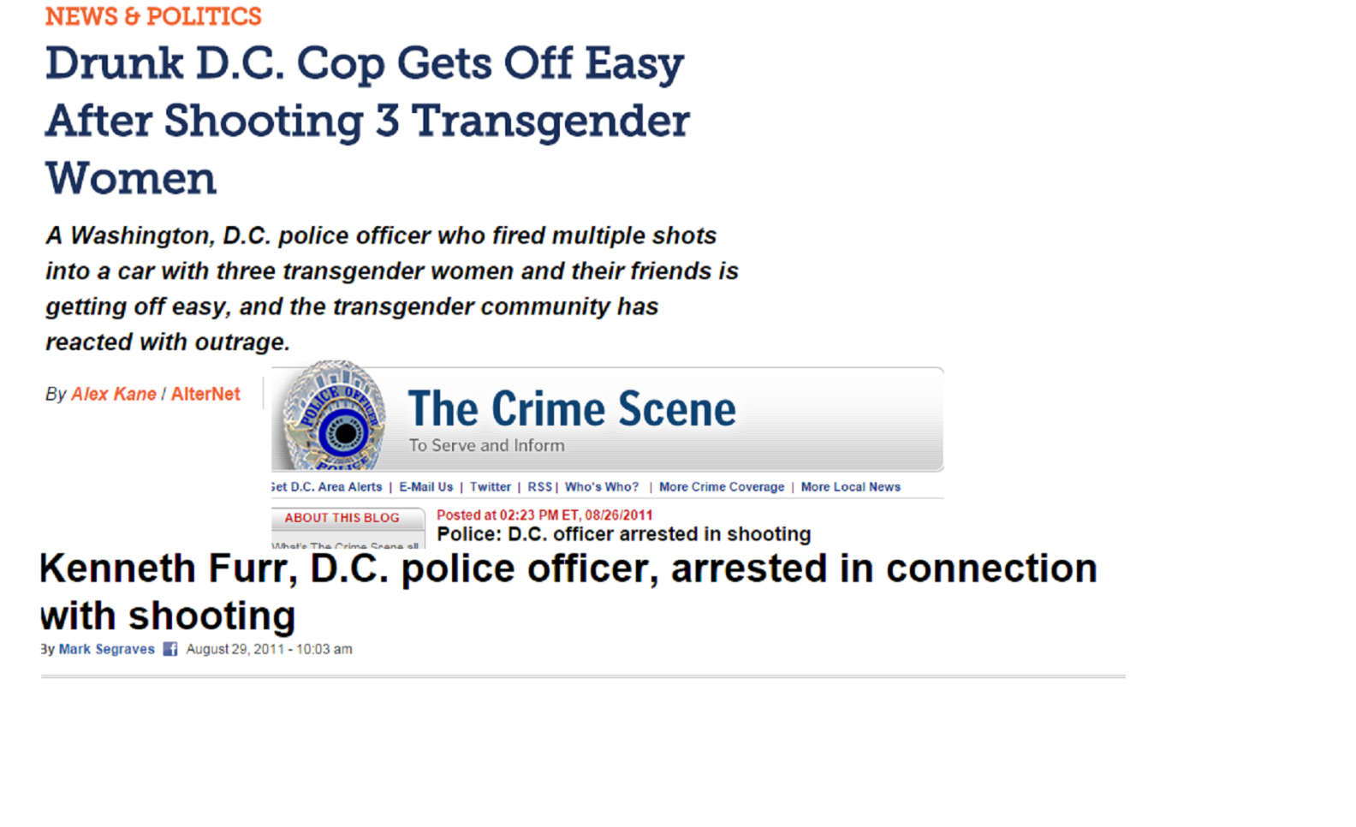
The Kenneth Furr Case
Notes:
August 2011; Washington, DC.
Mr. Furr, an off-duty police officer, asked a transgender woman for sex for money. After the woman refused, the officer followed her and pointed a gun at her.
A confrontation occurred between the officer and the friends of the trans woman. The officer drove away. The trans woman, two of her transgender friends, and several male friends followed the officer in their car.
The officer stopped and fired his gun at the other car. The driver of the other vehicle ducked to avoid being shot and rammed into the officer’s car.
The officer then climbed on the hood of the car occupied by the transgender women and their friends and fired five times through the front windshield, wounding three of them.
More police arrived and arrested the officer, who was drunk. He received three years of supervised probation, a $150 fine, and 100 hours of community service as his sentence for assault and solicitation of prostitution. He was acquitted of assault with a weapon with intent to kill.

Slide 19
Report of the Hate Crimes Assessment Task Force (2011)
Goals:
conduct an impartial review of police department programs supporting the LGBTQ community
compare them with programs in other departments in the nation
identify any areas that might be strengthened
Notes:
Hate Crimes Assessment Task Force: a small group of national civil rights organizations, advocacy groups, and recognized academic authorities with involvement and experience on the issues of community engagement and hate crimes.
Note: The Chief of Police of Washington, DC ordered this review of its practices and procedures; the final report is presented with an introduction written and signed by the Chief.

Slide 20
Hate Crimes Assessment Task Force Report (Continued)
Interviewed police officials, LGBTQ advocates and community leaders
Reviewed policies, procedures, training materials, and curricula relating to hate crimes and outreach to the LGBTQ community
Compared policies and procedures to those in other metropolitan police departments
Held four community meetings to get the perspectives of the general public

Slide 21
Hate Crimes Assessment Task Force Report (Continued)
Findings:
Strained relations between the LGBT community and the police department
Increase in the number of reported hate crimes over the previous five years
Insufficient information-sharing regarding hate crime cases, investigations, and disciplinary proceedings against officers charged with misconduct
Rampant homophobic and transphobic bias amongst police officers
Mistreatment of transgender people in particular, and unsolved homicides of transgender people

Slide 22
Washington-Specific Solutions
Strategies Implemented to Improve Police Relations with the LGBTQ Community in Washington, DC
Notes:
Note: Some of these pre-date the Report of the Hate Crimes Assessment Task Force

Slide 23
Gay and Lesbian Liaison Unit (GLLU)
117 officers with LGBTQ subject-matter expertise
Public education campaigns
Seek out information on hate crimes and violent crimes within the LGBTQ community
Conduct patrol functions
Notes:
Created in 2009 to address the deteriorating relationship with the LGBTQ community.
Note: Problems with leadership and structure. Between 2009 and 2011, weak leadership, poor training, and lack of subject-matter experts undermined the GLLU’s goals. This breakdown in part led to the Hate Crimes Task Force Report.

Slide 24
Cultural Competency Training
Gender identity and expression vocabulary and concepts
Inequalities LGBTQ people face
Specific issues officers need to know when dealing with LGBTQ-related cases
Reinforce legal protections and rights of LGBTQ people
Notes:
Training for officers by activist groups such as the DC Trans Coalition. The Office of Police Complaints has received this type of cultural competency training as well.

Slide 25

MPD General Order 501.02
Police department directive on “Handling Interactions with Transgender Individuals.”
Notes:
Internal police department policy.
Note Sections I, II, and IV.
Appears to be very progressive. Questions about whether or not police officers are following it.

Slide 26
DC Office of Police Complaints Community Partnership Program
Organizations, government agencies, social service providers, neighborhood associations, and advocacy groups
“Community Partners” have information and complaint forms available for their clients
Individuals can initiate the complaint process through their local community organization
Notes:
The Office of Police Complaints is an independent District of Columbia government agency that reviews and resolves complaints of misconduct filed by citizens against Metropolitan Police Department officers and is staffed by civilians.
The Office of Police Complaints has the authority to receive complaints involving six types of police officer misconduct: harassment, inappropriate language or conduct, retaliation, unnecessary or excessive force, discrimination, and failure to identify.
If the Office sustains the allegation, the matter is referred to the Chief of Police who can then discipline the officer.
If the police chief disagrees, the case is reviewed by a panel of three complaint examiners. If the panel upholds the decision of the original complaint examiner, the police chief must then impose the appropriate discipline on the accused officer.

Slide 27
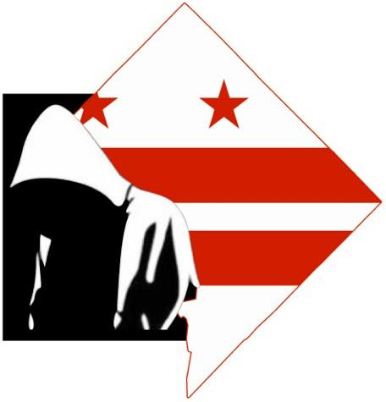
DC CopWatch
Notes:
A bystander used his cell phone to record a police officer shooting and killer Walter Scott in South Carolina.
Warning: Graphic Violence.
3:50
Note discrepancies between the video and the officer’s story before the video surfaced. The officer said the man grabbed his stun gun. Really, the man was running away and the officer shot him in the back. The officer can be seen placing the stun gun next to the man’s body. Once this video surfaced, the officer was charged with murder.

Slide 28
CopWatch (Continued)
Civilian recordings of police activity
Advantage: cameras and videos not controlled by police but rather by civilians
DC police department recognizes a Constitutional right to record police activity in public places
Notes:
Note: Not all States recognize a constitutional right to film police activity. No federal statute or Supreme Court case directly protects this right.

Slide 29
Sources
Protected and Served?, Lambda Legal, 2012, http://www.lambdalegal.org/protected-and-served
A Roadmap for Change: Federal Policy Recommendations for Addressing the Criminalization of LGBT People and People Living with HIV, Center for Gender & Sexuality Law at Columbia Law School and co-authored by the Center for American Progress, The Center for HIV Law & Policy, and Streetwise & Safe (SAS), May 2014, http://web.law.columbia.edu/sites/default/files/microsites/gender-sexuality/files/roadmap_for_change_full_report.pdf
National Center for Transgender Equality, http://transequality.org/issues/police-jails-prisons
S.1038: End Racial Profiling Act of 2013, https://www.congress.gov/bill/113th-congress/senate-bill/1038/text#toc-H84C0187FE5804905B508871E3D57705F
Report of the Hate Crimes Assessment Task Force, the Anti-Defamation League, the Human Rights Campaign, the National Center for Transgender Equality, the Leadership Conference for Civil and Human Rights, and two of the nation’s leading academic experts on the causes and impact of hate violence, Professor Jack McDevitt of Northeastern University and Professor Jim Nolan of West Virginia University, May 2011, https://dctranscoalition.files.wordpress.com/2014/03/hcatf-report.pdf
Fact Sheet: Strengthening Community Policing, The White House, December 2014, https://m.whitehouse.gov/the-press-office/2014/12/01/fact-sheet-strengthening-community-policing
Police and the Trans Community: Metropolitan Police Academy Training, The DC Trans Coalition, September 2011, https://dctranscoalition.files.wordpress.com/2009/10/dctc-gllu-intro-training-september-2011.pdf
Metropolitan Police Department Directive 501.02: Handling Interactions with Transgender Individuals, January 2015, https://go.mpdconline.com/GO/GO_501_02.pdf

